Slide 1
SALARY SURVEY OF 2021
DAYANA J A
DA&DS OCTOBER BATCH
Page 01/09

Slide 2
OVERVIEW
ANALYSED THE SALARY SURVEY OF 2021
CLEANED RAW DATASET
QUERIES FETCHED
PIVOT TABLE AND PIVOT CHART
CREATED DASHBOARD IN EXCEL
VISUALIZATION ON ANALYSIS
Page 02/09

Slide 3
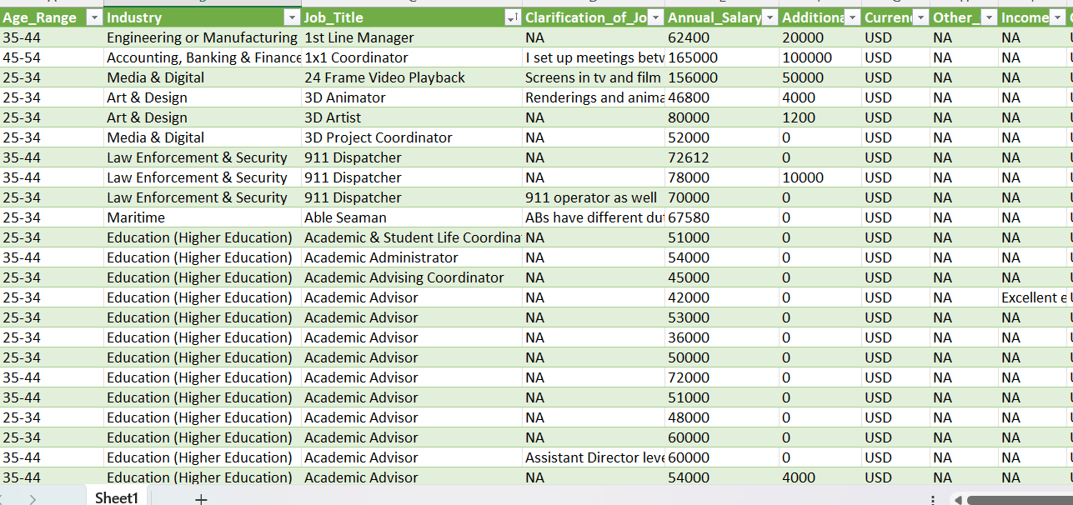
DATA CLEANING
HANDLING MISSING VALUES
REMOVE DUPLICATES
INCONSISTENT VALUES
STANDARDIZED DATA TYPES
Page 03/09

Slide 4
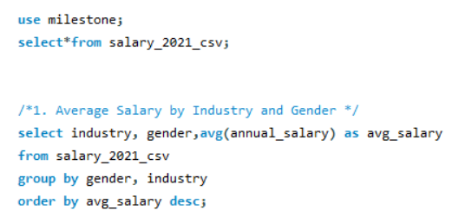
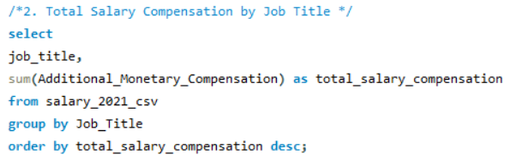
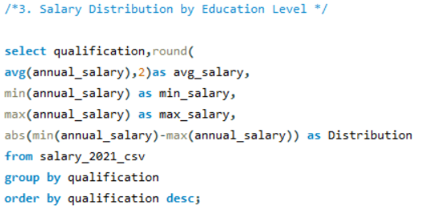
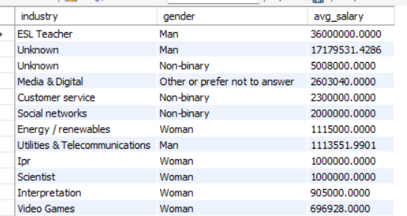
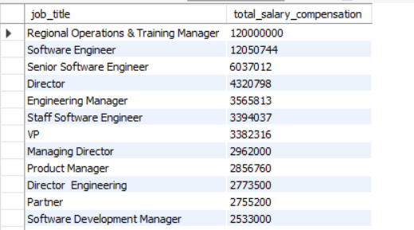
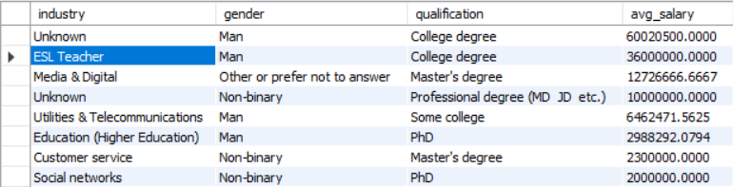
DATA QUERY
IMPORTED QUERIES INTO MYSQL
WRITTEN QUERIES AND FETCHED THE RESULT
EXPORTED THE DATASET TO EXCEL
Page 04/09

Slide 5
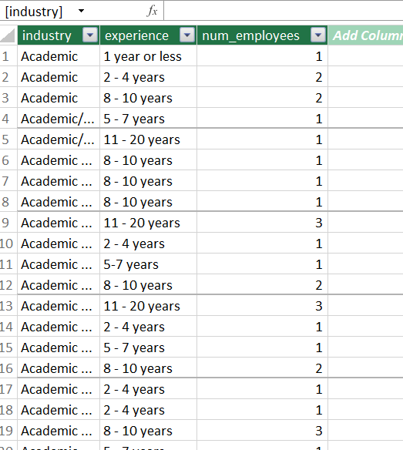
DATA MODELLING
AFTER EXPORTING, THE TABLES WERE COLLECTED IN SINGLE WORKBOOK
ADDED TABLES TO DATA MODEL IN POWER PIVOT
CREATED RELATION OVER THE TABLE
Page 05/09

Slide 6
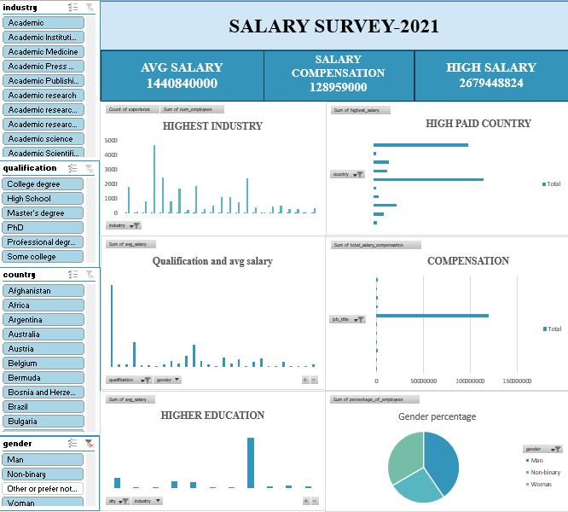
DASHBOARD

Slide 7
INSIGHTS
HIGHEST SALARY- ESL TEACHER- MAN, NON-BINARY
SCIENTIST, VIDEO GAMES, INTERPRETATIONAND BIO-TECH- WOMEN
COMPENSATION- TRAINING MANAGER, SOFTWARE ENGINEER,SENIOR DIRECTORS
SALARY BY EDUCATION LEVEL- PH.D, MASTER DEGREE
YEAR OF EXPERIENCE- COMPUTING & TECH – 1093 EMPLOYEES
HIGHEST SALARY COUNTRY- INDONESIA- SENIOR CONSULTANT
LOWEST SALARY COUNTRY- TANZANIA , INDIA
Page 07/09

Slide 8
CONCLUSION
GENDER EQUALITY
CITY INCOME IS NOT ENOUGH FOR THE COST OF LIVING
Page 08/09

Slide 9
THANK YOU
Page 09/09

